Slide 1
Perioperative Services Team
Updated 8-4-2025

Slide 2
Administrative Assistant/Billing Analyst
Systems Analyst
Perioperative Services Director
Nurse Educator
Nurse Educator
Operating Room
Nurse Manager
SPD Manager
PACU/Phase II PSAT/SAU/Endo
Nurse Manager
Perioperative
Business Manager
Operations
Coordinators
(Day, Night)
Clinical Operations Coordinators
(Day, Night)
Endoscopy
Clinical
Coordinator
Clinical Coordinators
(SAU, PSAT)
PACU/Phase II
Clinical Coordinator
OR Billing Analysts
Team Coordinators & Assistant Coordinators
Anesthesia Techs
Team Leaders
Endoscopy Staff
SAU & PSAT Staff
PACU/
Phase II Staff
OR Buyer
OR Staff
SA’s, ST’s, RN’s, Core Techs
SPD Techs,
Clinical Supply Techs
OR Resource Coordinator
OR Supply Techs
Operating Room
Unit Secretary
Perioperative Services Organizational Chart

Slide 3

Who is in our Operating Room (OR)?
Surgeons
Physician Assistants (PA)
Nurse Practitioners (NP)
Surgical Assistants (SA)
Registered Nurse First Assists (RNFA)
Anesthesiologists
Certified Registered Nurse Anesthetists (CRNA)
OR Circulating RNs
Surgical Technologists
OR Anesthesia Techs
OR Core/Supply Techs
Sterile Processing Techs (SPD techs)
Medical Reps / Vendors
X-Ray Techs

Slide 4
Perioperative Phases of Care
Used to describe the care provided in the total surgical experience of the patient.
  Preoperative
    Time from when the client is admitted in the surgical unit - to the time they are prepared for the surgical procedure - until they are transported to the Operating Room
  Intraoperative
    Time from when the client is admitted to the Operating Room - to the time of admin of anesthesia - surgical procedure is performed - until they are transported to recovery/ICU
  Postoperative
    Time from when the patient is admitted to PACU (Post Anesthesia Care Unit) - to the time they are transported to an Inpatient unit or discharged home - until follow-up care

Slide 5

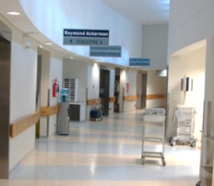


Perioperative Zones
Unrestricted Zone
  Free movement
  Street clothes
Semi-Restricted Zone
  Divided from Unrestricted areas by red demarcation lines on floor
  Surgical attire required including corridors
    Surgical Scrubs
    Surgical Hats
    OR dedicated shoes
Restricted Zone
  Surgical attire required including ORs
  Movement in and out of OR is kept to a minimum

Slide 6
Classifications of Surgical Procedures
Diagnostic: To establish the presence of a disease
Exploratory: To determine the extent of the disease condition
Curative: To treat the disease and/or condition
      Ablative: Removal of organ
      Constructive: Repair of congenitally defective organ (plasty, pexy)
      Reconstructive: Repair of damaged organ
Palliative: To relieve distressing signs and symptoms, not necessarily to cure the disease or condition

Slide 7
Surgery Classifications
According to Urgency
Classification | Indication | Examples
Emergent Patient requires immediate attention; Life-threatening condition | Without delay | Severe bleeding Gunshot/stab wounds Fractured skull
Urgent/Imperative Patient requires prompt attention | Within 24-30 hours | Kidney/ureteral stones
Required Patient needs to have surgery | Plan within a few weeks or months | Cataract Thyroid d/o
Elective Patient should have surgery | Failure to have surgery, not catastrophic | Repair of scar Vaginal repair
Optional Patient’s decision | Personal preference | Cosmetic surgery

Slide 8


In the OR: Now what!?
The RN Circulator will direct you where to stand
Understand what is sterile
  The “Sterile Field” is the area around the patient with prepared instruments, supplies, and equipment that will be used during the procedure.
  If it is BLUE or GREEN, don’t touch it!
12 inches minimum
  IMPORTANT:
    Clear plastic can also be sterile; i.e. sterile drapes for x-ray equipment or microscopes.
    If you are unsure if an item is sterile, assume it is sterile until instructed otherwise.
    OR staff who are “scrubbed in” are also considered sterile.
      Maintain a safe distance from anyone “scrubbed in”. Minimum of 12 inches.
      Never turn your back to the sterile field.
1 12
Scrubbed in
NOT
Scrubbed in

Slide 9
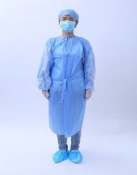
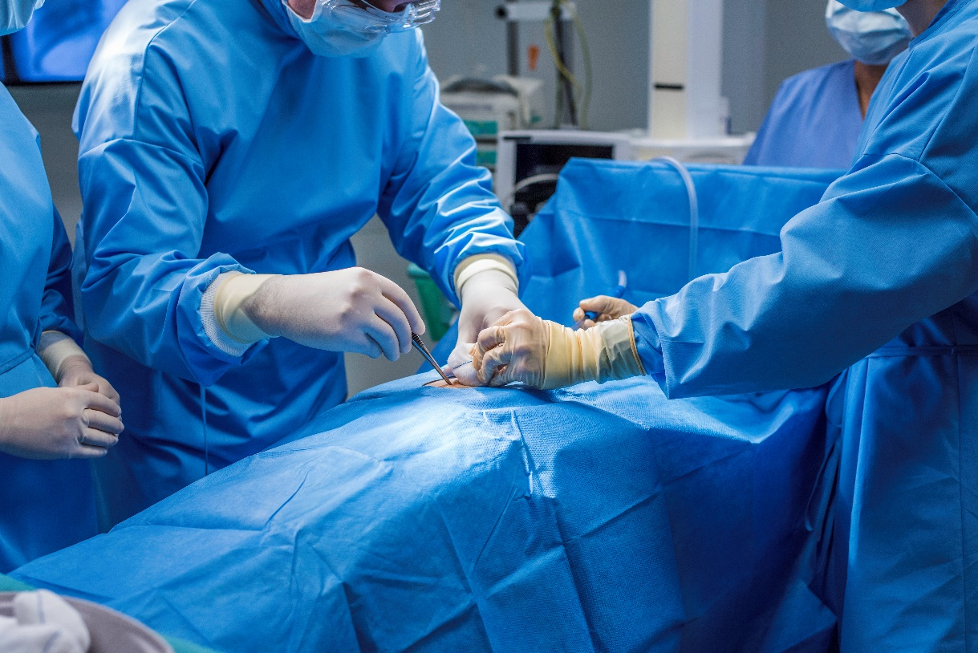

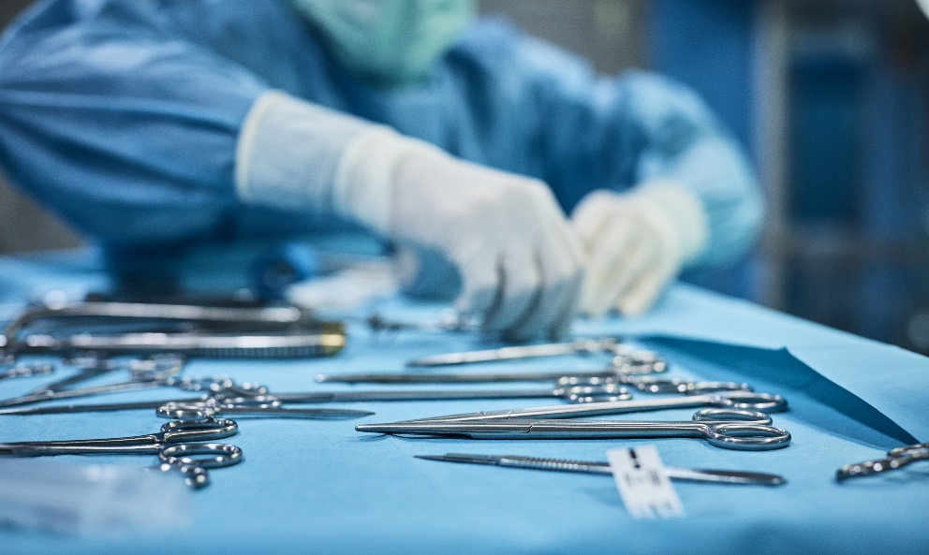

Examples of Sterile Fields & Staff “Scrubbed In”

Slide 10
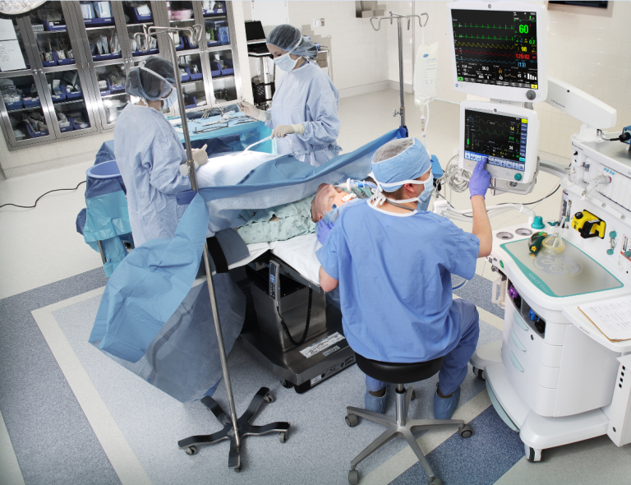
Anesthesia Provider Area
The Anesthesia provider area is located behind the surgical drape/field.
This area is NOT sterile.

Slide 11

What if you think you may have contaminated something sterile?
Notify OR staff immediately
The OR staff is trained to take care of contaminations, so the patient is not exposed.
If you see someone else contaminate something – You can say something too!
We all work together as a team
to keep the patient safe.

Slide 12
References
AORN (2024). Perioperative standards and recommended practices: Recommended practices for traffic patterns in the perioperative setting.
Andersson, A.E., Bergh, I., Karlsson, J., Eriksson, B.I., & Nilsson, K.(2022). Traffic flow in the operating room: An explorative and descriptive study on air quality during orthopedic trauma implant surgery. American Journal of Infection Control, 40, pp. 750-755.

